Slide 1
Hilbert’s Problems and Complexity
In 1900, mathematician David Hilbert delivered a now-famous address at the International Congress of Mathematicians in Paris.
Identified twenty-three mathematical problems and posed them as a challenge for the coming century.
Hilbert's tenth problem was to devise an algorithm that tests whether a polynomial has an integral root. [Some polynomials have an integral root and some do not.]
Hilbert's tenth problem asks in essence whether the set D is decidable.

Slide 2
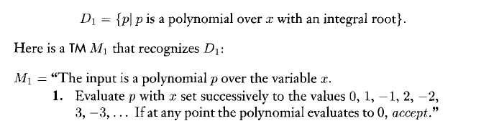

Hilbert’s Problems and Complexity
For single variable:
If p has an integral root, M1 eventually will find it and accept. If p does not have an integral root, M1 will run forever.
For single variable, bound exist.
For multivariable, no such bound exist.

Slide 3







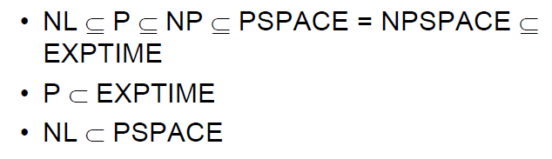
Complexity Classes

Slide 4
Hierarchy of Complexity Classes
Undecidable
Decidable
PSPACE ⊂ EXPSPACE
EXPSPACE
P ⊂ EXP
NEXP
EXP
PSPACE = NPSPACE
PSPACE
P ⊆ NP ⊆ PSPACE
NP
P =? NP
P

Slide 5

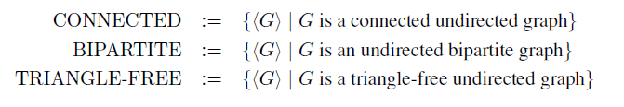
Complexity Class P

Slide 6
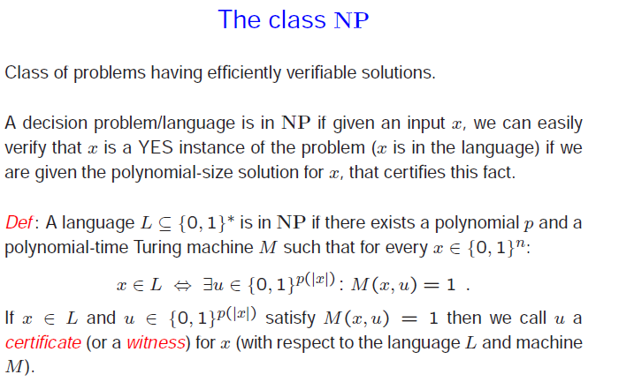
Complexity Class NP

Slide 7
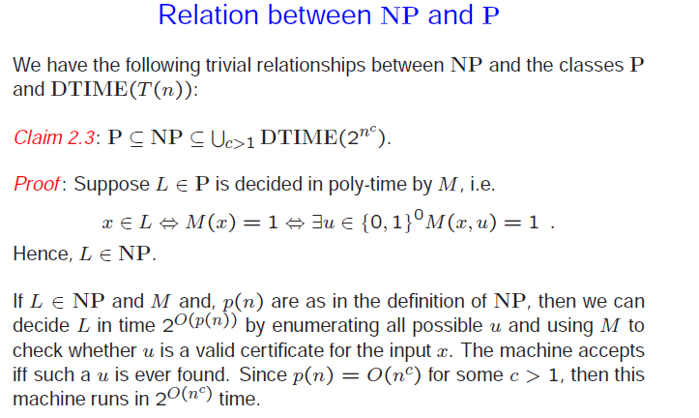
Complexity Class NP

Slide 8
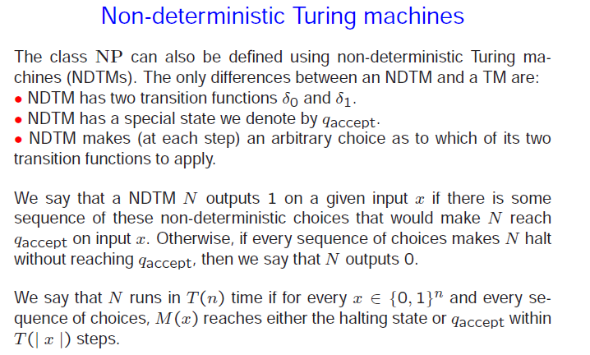
Complexity Class NP

Slide 9
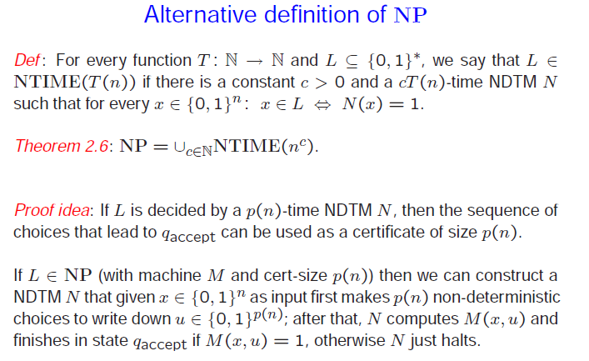
Complexity Class NP

Slide 10
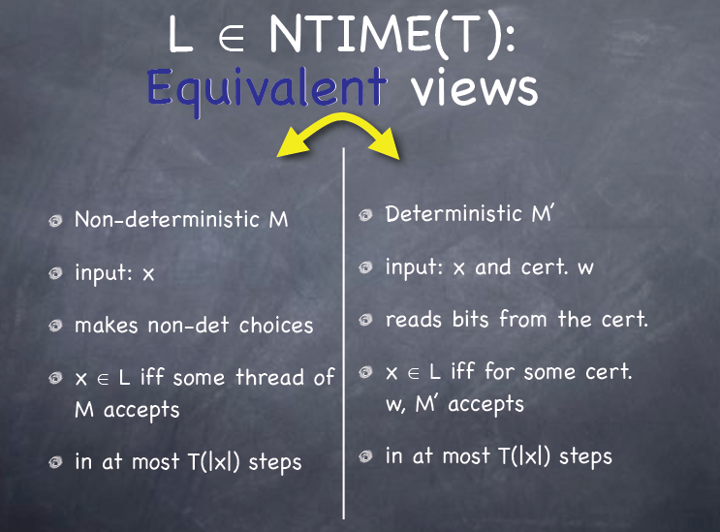
Complexity Class NP

Slide 11
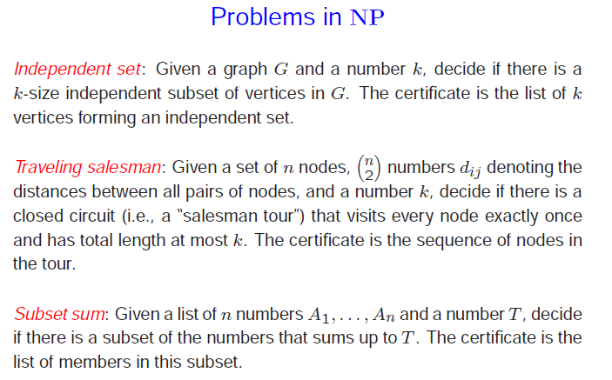
NP: examples

Slide 12
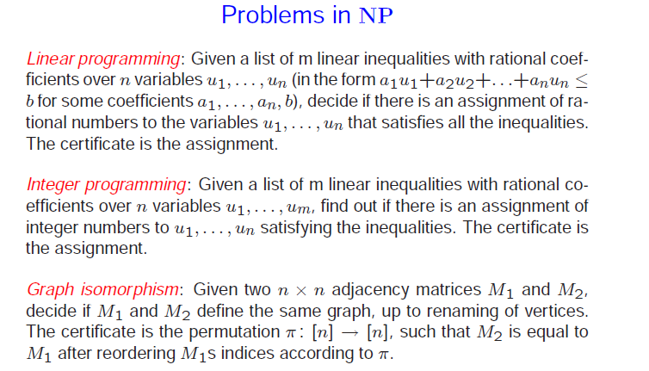
NP: examples

Slide 13
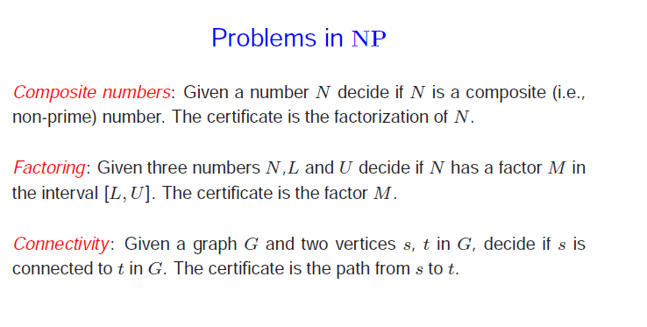
NP: examples

Slide 14
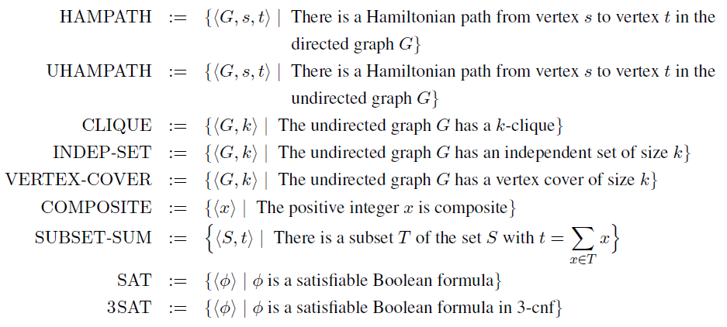
NP: examples

Slide 15

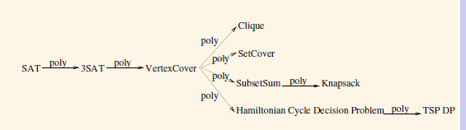
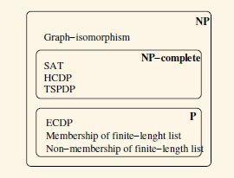
NP Complete

Slide 16
P & NP-Complete Problems
Shortest simple path
  Given a graph G = (V, E) find a shortest path from a source to all other vertices
  Polynomial solution: O(VE)
Longest simple path
  Given a graph G = (V, E) find a longest path from a source to all other vertices
  NP-complete

Slide 17
P & NP-Complete Problems
3-CNF is NP-Complete
Interestingly enough, 2-CNF is in P!

Slide 18
P & NP-Complete Problems
Euler tour
  G = (V, E) a connected, directed graph find a cycle that traverses each edge of G exactly once (may visit a vertex multiple times)
  Polynomial solution O(E)
Hamiltonian cycle
  G = (V, E) a connected, directed graph find a cycle that visits each vertex of G exactly once
  NP-complete

Slide 19
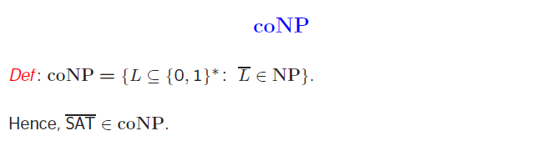

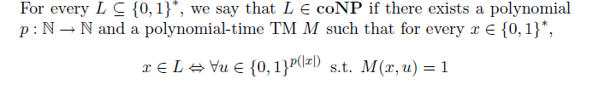
Complexity Class coNP

Slide 20
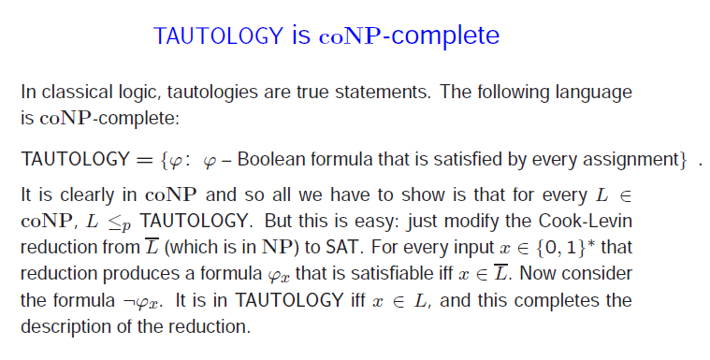
coNP Complete

Slide 21
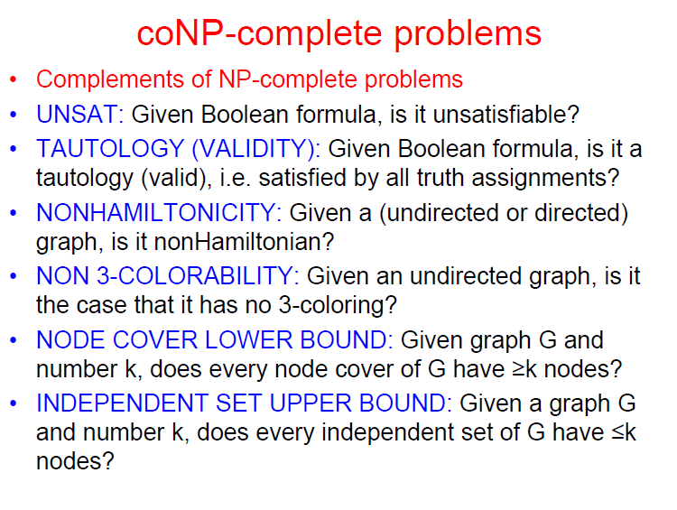
coNP Complete

Slide 22
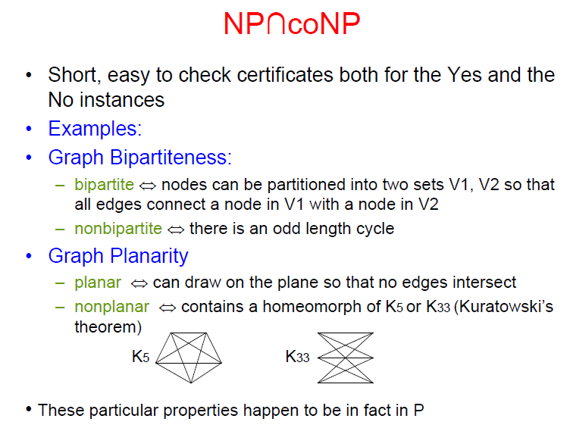
NP and coNP

Slide 23
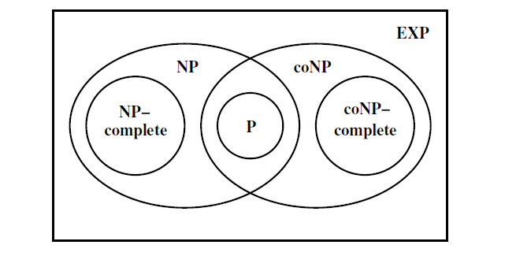
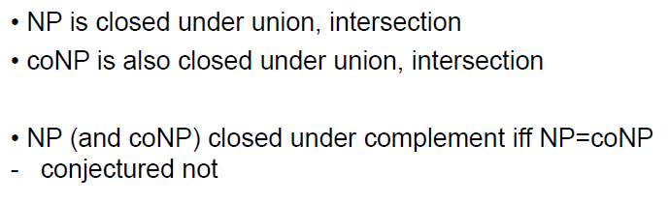
P, NP, coNP

Slide 24
NP-naming convention
NP-complete - means problems that are 'complete' in NP, i.e. the most difficult to solve in NP
NP-hard - stands for 'at least' as hard as NP (but not necessarily in NP);
NP-easy - stands for 'at most' as hard as NP (but not necessarily in NP);
NP-equivalent - means equally difficult as NP, (but not necessarily in NP);

Slide 25
Decision Vs. Optimization
Decision problem: a question that has two possible answers yes or no. The question is about some input.
Optimization problem: find a solution that maximizes or minimizes some objective function

Slide 26
Decision Vs. Optimization
Decision problem:
Given a graph G and a set of vertices K, is K a clique?
Given a graph G and a set of edges M, is M a spanning tree?
Given a set of axioms (boolean expressions) and an expression, is the expression provable under the axioms?

Slide 27
Decision Vs. Optimization
Optimization problems are not stated as "yes/no' questions.
An optimization problem can be transformed to a decision problem using a bound on the solution
Example:
  TSP Optimization: Find the shortest path that visits all cities
  TSP Decision: Is there a path of length smaller than B?

Slide 28
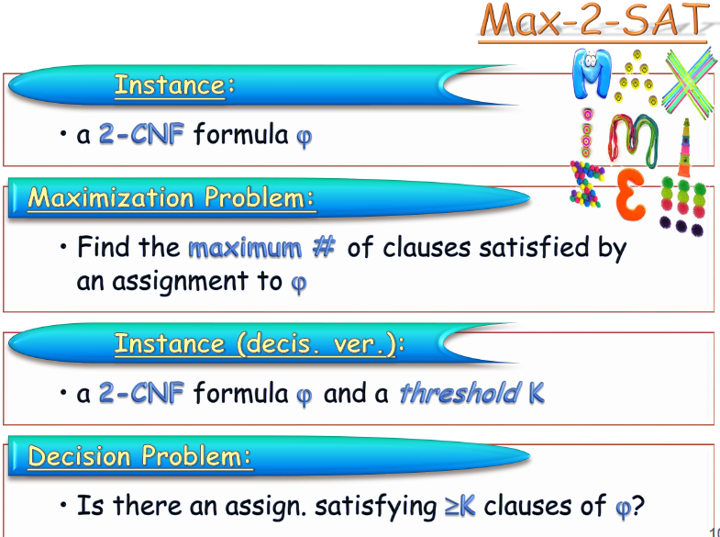
Max2Sat is NP-Complete

Slide 29
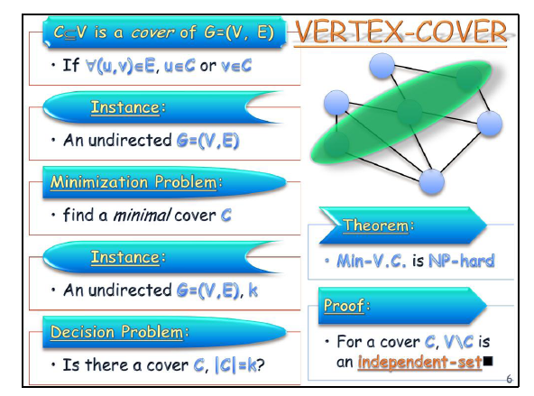
NP-hard problems: example

Slide 30
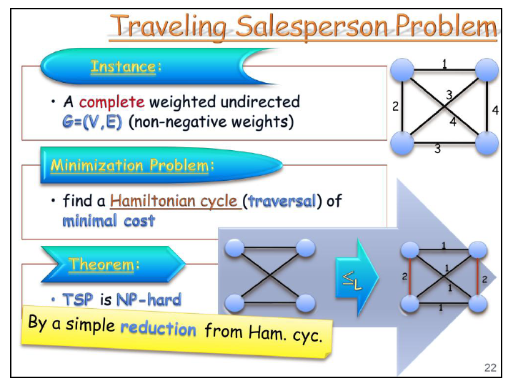
NP-hard problems: example

Slide 31
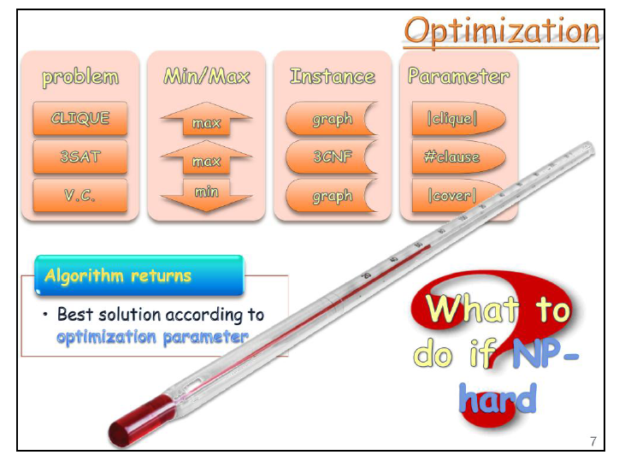
NP-hard problems: example

Slide 32
NP-hard problems: example
Halting Problem is NP-hard decision problem, but it is not NP-complete.
For this let us construct an algorithm A whose input is a prepositional formula X.
Suppose X has n variables. Algorithm A tries out all 2^{n} possible truth assignments and verifies if X is satisfiable.
If it is satisfied then A stops. If X is not satisfiable, then A enters an infinite loop. Hence A halts on input iff X is satisfiable.
If we had a polynomial time algorithm for the halting problem, then we could solve the satisfiability problem in polynomial time using A and X as input to the algorithm for the halting problem .

Slide 33
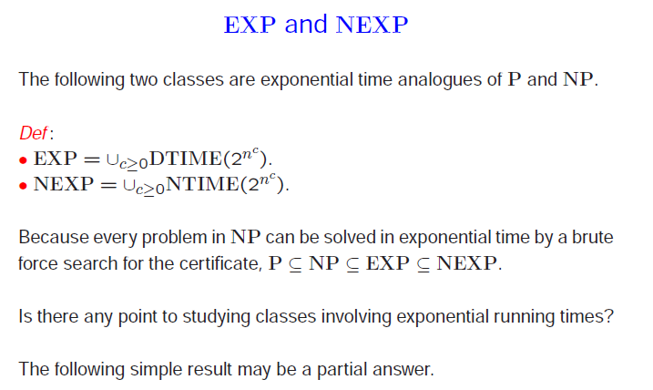
Complexity Classes EXP, NEXP

Slide 34
Complexity Class EXP
Generalized chess is the game of chess played on an n-by-n board, with 2n pieces on each side.
For many generalized games which may last for a number of moves exponential in the size of the board, the problem of determining if there is a win for the first player in a given position is EXPTIME-complete.
SUCCINT representation of P problems.

Slide 35


Complexity Class NEXP
SUCCINCT HAMILTON PATH:
  A Boolean circuit with 2n inputs and one output represents a graph on 2^{n} vertices. To determine if there is an edge between vertices i and j, encode i and j in n bits each, and feed their concatenation to the circuit: there is an edge between these vertices iff the output of the circuit is true.
Given such a circuit, is there a Hamilton path in the graph represented by the circuit?
For some NP-complete problems, there's a SUCCINCT variant that's NEXP-complete. E.g., SUCCINCT 3SAT, SUCCINCT KNAPSACK, etc.

Slide 36
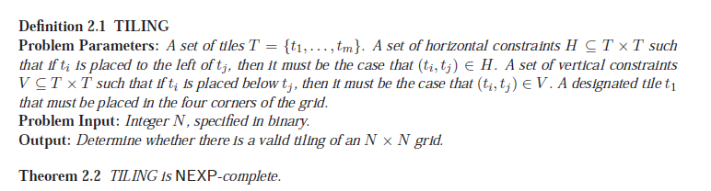
Complexity Class NEXP
Satisfyability of true boolean quantified formulas is NEXP.

Slide 37
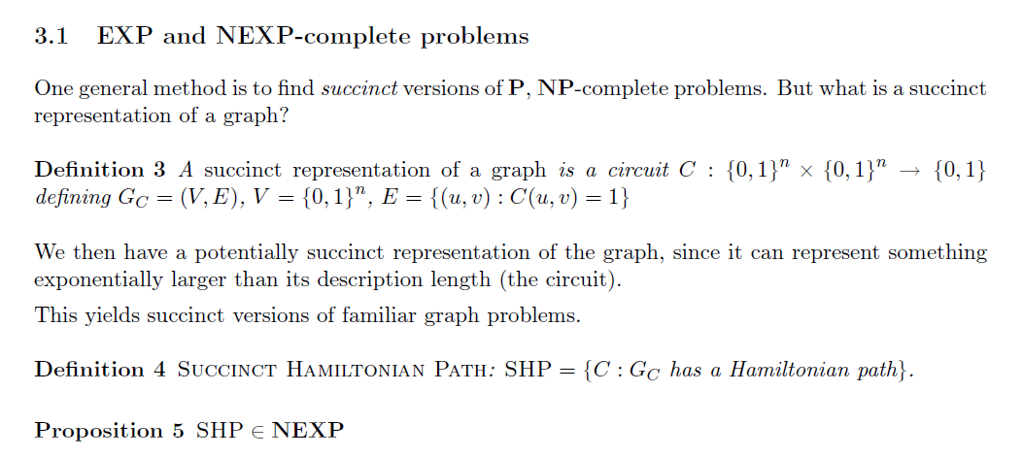

Slide 38
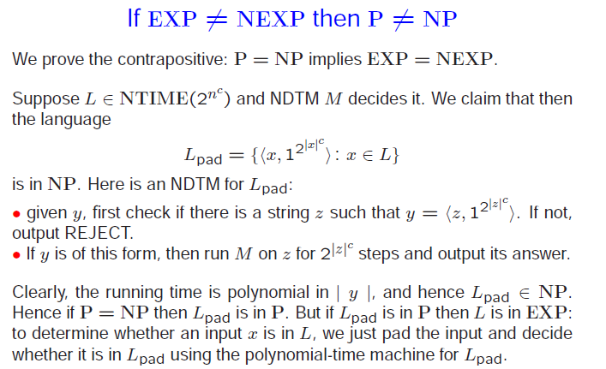
Complexity Classes EXP, NEXP

Slide 39
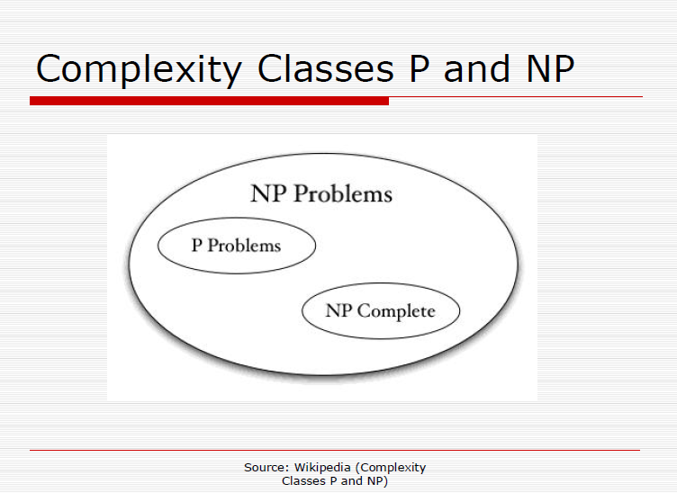

Slide 40
